Slide 1


Slide 2
Addison HVAC History
Company started in 1949
Company purchased by Heat Controller in 1995
Company purchased by Fedders in 2004
Company purchased by Roberts Gordon in 2008
Roberts Gordon Company purchased by investment group Specified Air Solutions

Slide 3









Slide 4
Background: The science of humidity control

Slide 5
A building’s air conditioning load comes from a variety of sources
 | External | Internal
Thermal (Sensible) | Heat conduction through envelope Fenestration OA Ventilation (sensible portion) Infiltration (sensible portion) | Lights Fans & other motors Office equipment and electronics Miscellaneous plug loads People (sensible portion) Industrial machinery
Moisture (Latent) | OA Ventilation (latent portion) Infiltration (latent portion) Permeation | People (latent portion) Plants Cooking Pools, showers, spa Washing/ Wash-downs Drying processes Other wet processes
Notes:
There are two types of loads that you are dealing with when you talk about the air conditioning load of a building. The one that is the most obvious and the most thought of is the thermal, or sensible load because that’s what we see on our thermostat. People adjust the temperature on their thermostat to control the temperature and it’s usually the largest portion of what we’re trying to control in a space.
However there is also the moisture or what engineers call the latent load in a building. Air conditioning systems need to reduce the humidity brought into a building from the outdoors, through either ventilation air or infiltration and also take care of the indoor moisture created in the space from the people in the room – and other elements you might have such as plants, cooking, pools, showers, spa that create moisture in a building.
To have comfortable, healthy conditions in a building, it’s important to look at both of these loads as essentially different challenges that must be addressed by your air conditioning system.

Slide 6
Air conditioning loads require both temperature and humidity control
  Conventional A/C Process
Primary Sources
  Lighting
  Thermal conduction
  Solar gains
  Plug loads
  Occupants
  Outside air ventilation & infiltration
  Occupants
  Typical Building
  A/C Load
  Temperature
  Reduced directly by absorbing heat into the refrigerant
  Temperature Control
  (sensible load)
  Humidity
  Reduced indirectly by overcooling air past DB LAT then reheat to maintain space temperature
  Humidity Control
  (latent load)
Though not apparent on the thermostat, humidity control is equally important to temp control for maintaining comfort, indoor air quality, and building integrity
Notes:
In the conventional air conditioning process, you’re treating both the thermal and moisture loads with one piece of equipment.
What’s typically happening is your temperature, that thermal load, is being treated directly. You have a cold coil in either an air handler, DX packaged unit or something similar, and you’re passing warm air over that cold coil to extract the thermal energy directly from the air.
On the other hand, the humidity is removed in an indirect fashion. If you look at a coil and the fins on that coil, you see that they are not able to extract moisture out of the air. What they can do is cool the air passed the dew point. Once air is cooled passed the dew point, the moisture will condense out of the air.
Just like at night when the air temperature cools down passed the dew point and you get condensation, you wake up in the morning and there is dew on the grass. The same is happening here, you get dew or condensation on your coil and it will collect at the bottom of the unit into a drip pan and then it will drain away.
This approach is not a direct process. You can only remove moisture by overcooling the air. So in essence, a conventional air conditioner is pretty strong at dealing with that thermal load, but not as efficient at dealing with that humidity load.
And even though you don’t see the humidity load on the thermostat, it’s equally important for the comfort and the health of the human occupants of the building, for indoor air quality, mold prevention and also for protecting the structure and furnishings of the building.

Slide 7
The fraction of moisture load in HVAC is substantially increasing in building design standards
Boston Example Building
ILLUSTRATIVE
13
15
13
(Btu/ft²)
3
6
6
Typical building “design” load is currently 20-40% moisture load, but evolving towards 40-60%
Percent Moisture Load (1- SHR)
Continued trend
ASHRAE Standard Year
Increased ventilation rates
Better energy efficiency
Continued energy efficiency
Greater awareness of IAQ/airborne pathogens
Florescent lighting
Insulation / envelope
Low -E glass
Etc.
CFL/LED
White roofs
Plug load reduction
Etc.
Source: TIAX
Notes:
Here is a graph of how air conditioning loads have evolved over time, starting in the 1980’s until 2005. This shows the relationship over time between that thermal load, the orange portion, and that moisture load which is the blue portion. While these are illustrative numbers, you can see that a lot has changed in building standards over time period.
Back in the 1980’s if you built a building, you would find that easily 80% of your load, even in a relatively humid climate, would be thermal. So the fact that your air conditioner didn’t have a lot of capacity to deal with moisture was not a big issue.
However, in the late 1980’s the standards changed. Ventilation rates increased significantly due to research that was done on indoor air quality, airborne microbes and airborne contaminants. After that, there were a lot of the energy efficiency improvements that addressed the thermal load. Rather than incandescent lights, most facilities switched over to fluorescent lights, there was better insulation and sealing of buildings, and window glazing to prevent the heat from gathering in the building. So you ended up with a lot of energy efficiency improvements that addressed only that thermal portion.
So what’s happening when you look at this fraction here is the percent of the load that’s thermal, otherwise known as the Sensible Heat Ratio, meaning sensible load over the total load has dropped down, in a humid climate, from 80% to only about 60%.

Slide 8
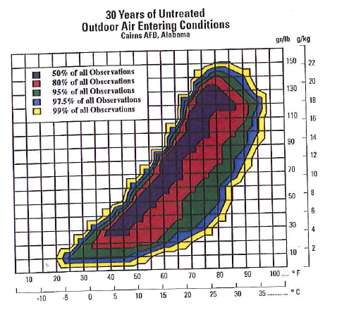
Traditional “design” conditions do not reflect the true challenge of moisture control in modern buildings
Humidity design condition
30 Years Observed Outdoor Air Conditions Cairns AFB Alabama
Cooling design condition
Moisture Content
Temperature
Part load condition
Realistically, the worst-case conditions are already at about 50% - smart designers are increasingly moving away from the “cooling design” load
Source: TIAX
Notes:
This is all graphed for what you’d call your design day. This is what an engineer would typically use to design because they tend to look at the thermal load as the major portion of the load. But if you look at the outdoor air weather conditions, this graphs, by frequency, the hours that fall into different temperature regimes and different moisture content levels, you can see that this design condition was chosen to represent the hottest day of the year, or in ASHRAE terms, it will be the 99.6 hottest day of the year. (Only .4% of the hours are hotter than that.) This may not be the most challenging condition anymore.
You also have the humidity design condition which is the 99.6 most humid day and if you look at that day, you start to see that it’s going beyond that 60% threshold and it’s almost 50/50 moisture load versus thermal load in a humid climate. These design conditions are happening for 35 hours a year.
The most common situation are what you call your part load conditions so look at this purple area: here you have a warm summer day that’s not overly warm but is still relatively humid. You’re really concerned about these days since they are going to happen for hundreds or thousands of hours per year. So when you look at that condition, what you start to see is that even in climates that aren’t that humid, that dark blue line is Albuquerque, you’re going to end up with a pretty even split in the responsibility between moisture control and temperature control.
Keep in mind that this refers to just your average, typical building (not one with greater humidity challenges)…

Slide 9
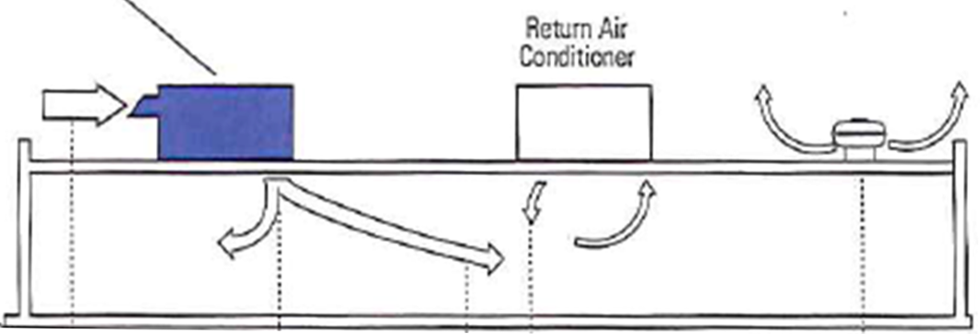
ASHRAE best practice design standards call for separate equipment to treat ventilation and/or latent loads
  ASHRAE Handbook Ch. 6.7: Although most centralized and decentralized systems are very effective at handling the space sensible cooling and heating loads, they are less effective (or ineffective) at handling ventilation air or latent loads. As a result, outside air should be treated separately.
Addison or 100% OSA System
Return Air
Conditioner
Notes:
As a result of this inadequate humidity control, ASHRAE has changed its recommendation for how to manage this challenge. Of course I promote equipment that deals directly with humidity but I wanted to show you this quote right out of the ASHRAE handbook… (read quote).
Here they are talking about dedicated outdoor air systems but you can take the same logic and say that anywhere you have a high latent load, anywhere you’re going well beyond that 80% thermal load, you should be thinking about a separate piece of equipment to deal with the latent load. You can then take the remaining thermal load and treat that with normal return air systems such as a DX or chilled water system and that’s going to be totally adequate. Just isolate those humidity loads into separate equipment to deal with that portion of the load.

Slide 10

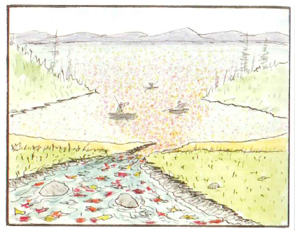
Best Practice - dry the air before it enters the building
Lower First Cost, System Simplification
Higher First Cost, More Complex
After all the leaves mix into the lake, it will take more people and more work
to chase them all down and fish them out.

Slide 11
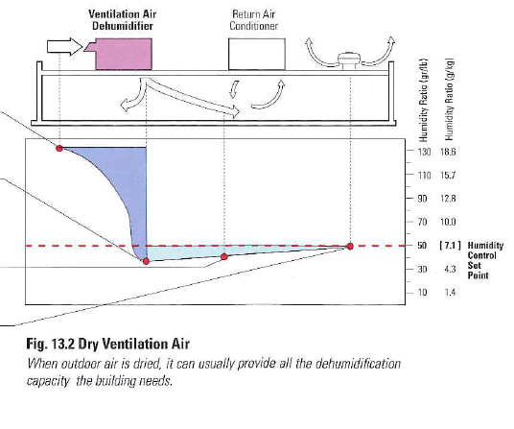
Dried outdoor air can provide all the dehumidification capacity the building requires.
Outdoor Air
Hot and humid, it must be cooled and dehumidified.
Dehumidifier
Dries the incoming air to a condition below the desired space humidity set point
Dry Ventilation Air
Will remove the moisture loads generated inside the building.
Air Inside the Space
Is it at or below the desired humidity set point.

Slide 12
Dew Point Comparison
Reheating to Neutral Air
 | DRY BULB TEMPERATURE - °F
 | 70°F | 72°F | 75°F
DEW POINT | RELATIVE HUMIDITY – RH %
45°F | 40.6 | 37.9 | 34.3
50°F | 49 | 45.8 | 41.4
52°F | 52.7 | 49.3 | 44.6
55°F | 58.9 | 55.1 | 49.7
57°F | 63.36 | 59.2 | 53.5
60°F | 70.6 | 65.9 | 59.6
65°F | 84.2 | 78.6 | 71.1

Slide 13
100% Outside Air Examples

Slide 14
100% Outside Air
Summer Design w/Reheat
Supply Temp.
55.0/55.0
Ambient
92/75
Leaving Air
79.7/64.1
120
1800 cfm
Notes:
These are design conditions. The unit is operating at 100% Capacity.

Slide 15
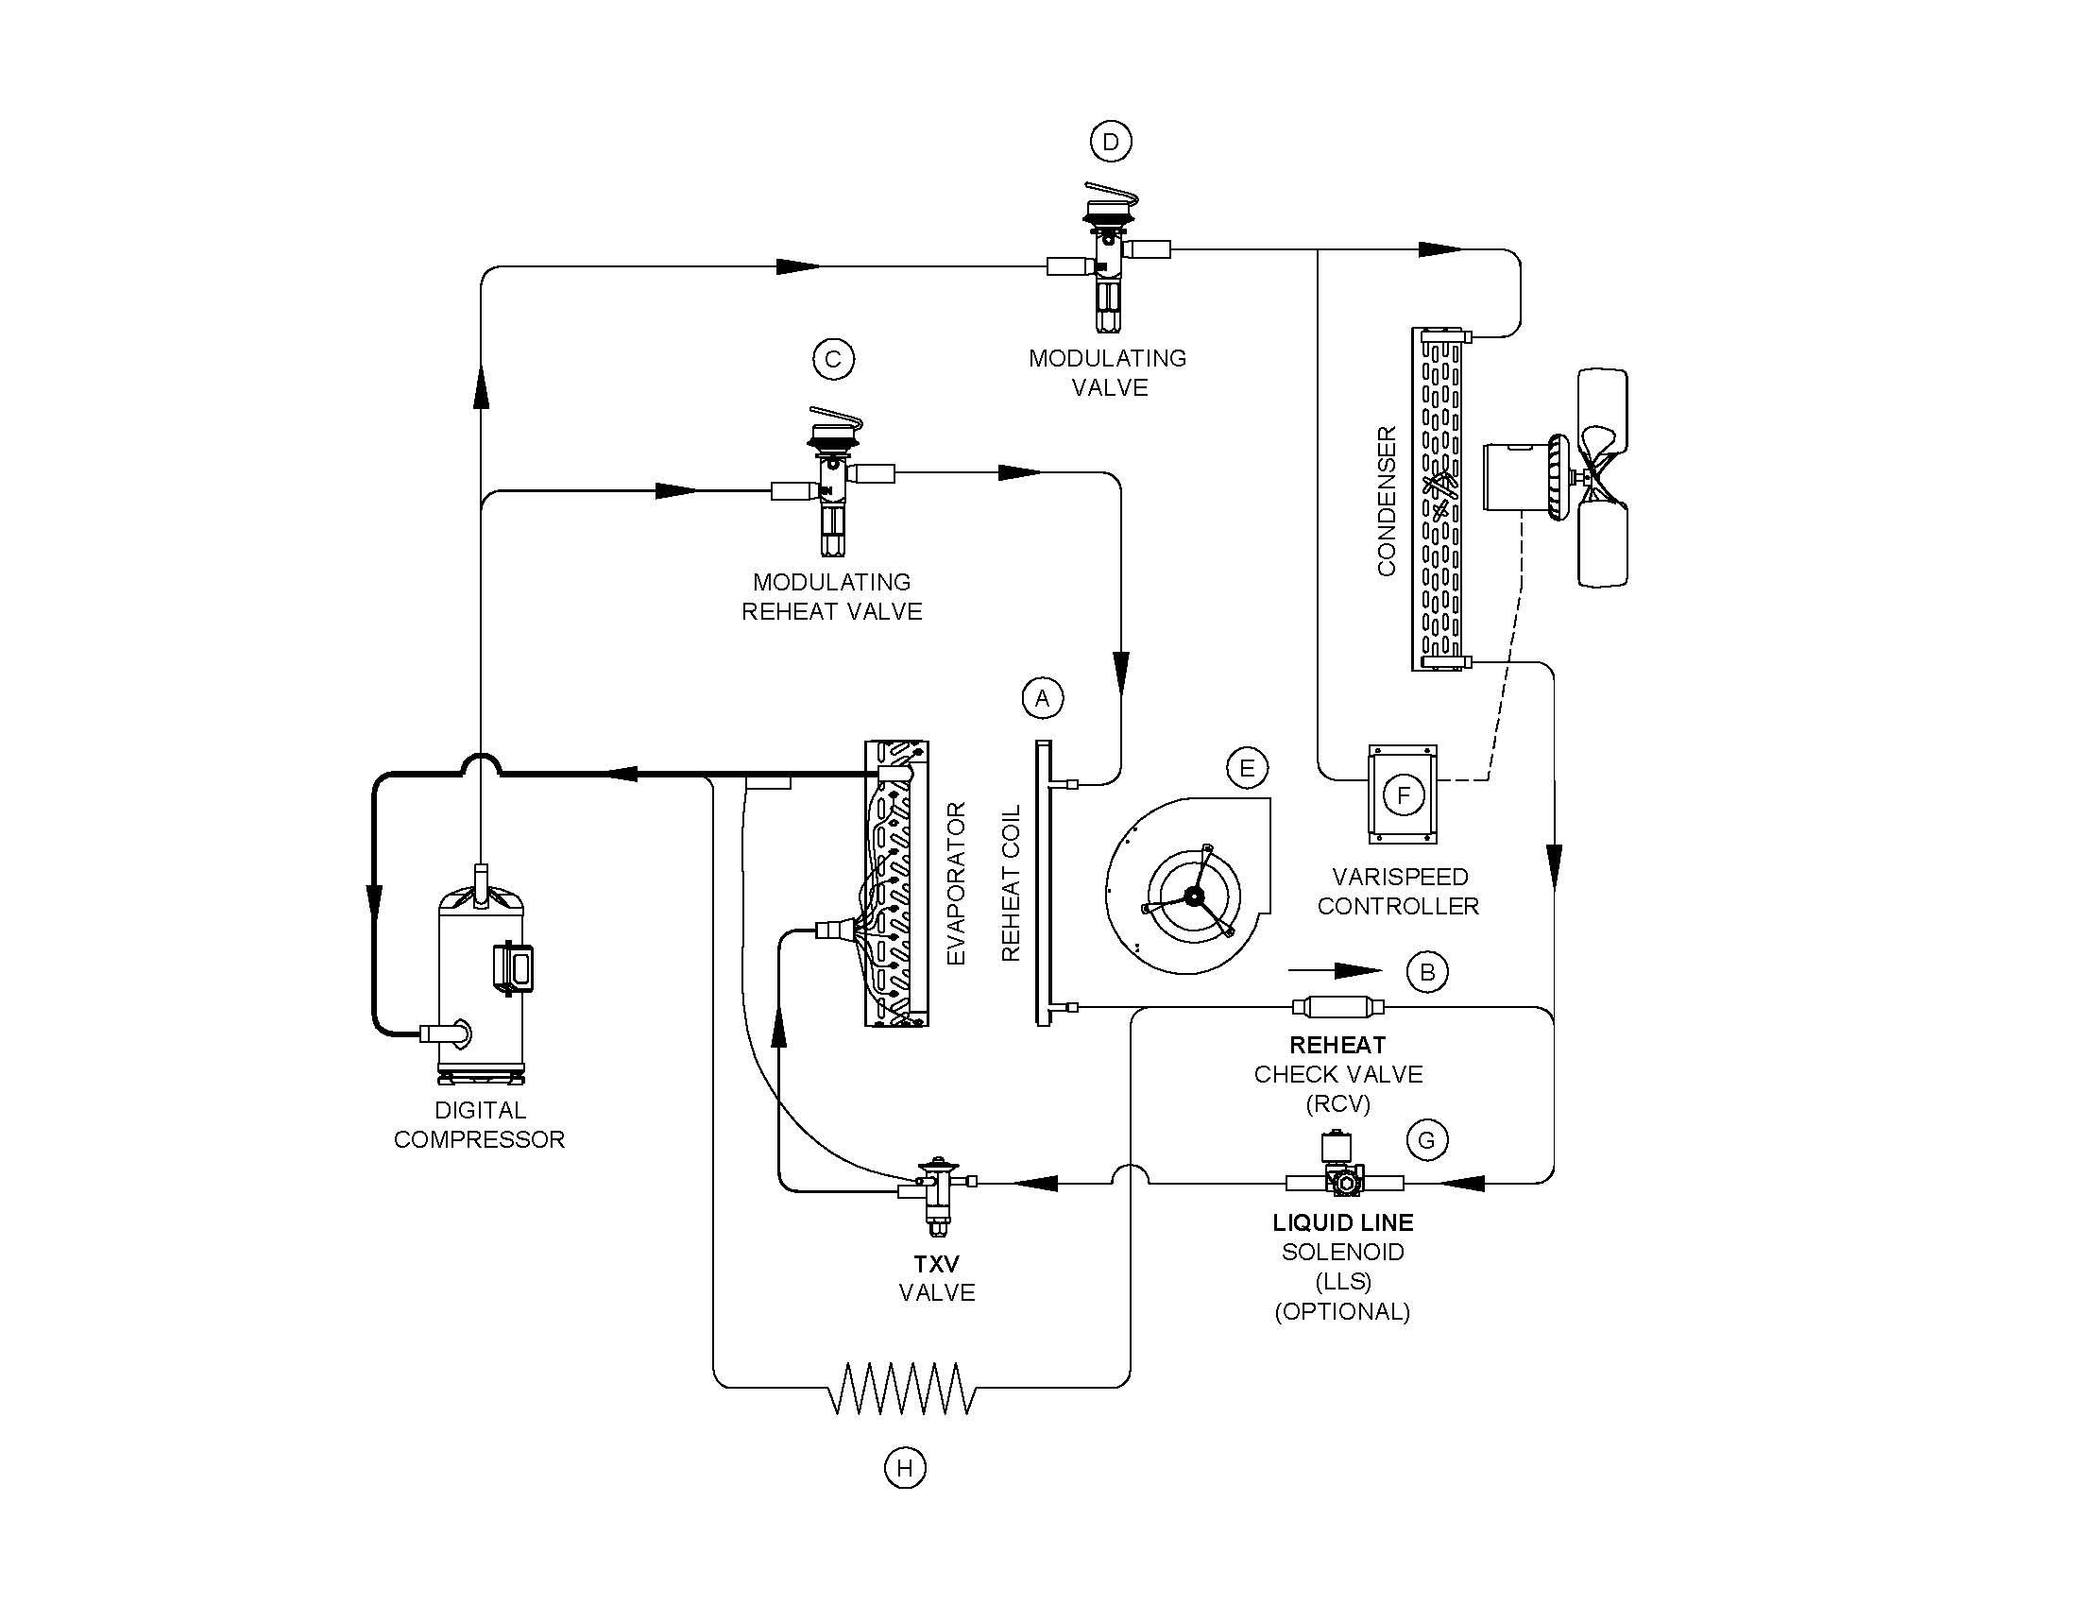
Hot Gas Reheat Using Digital Scroll
Notes:
When using a digital scroll, the hot gas bypass requirement is not needed. The unit will maintain neutral air by means of capacity reduction- down to 10%.

Slide 16
100% Outside Air
Part Load w/Reheat Plus Sub-cooling
Liq. Sub-cool
55.2/52.1
Supply Temp.
50.4 D.P.
Ambient
60/60
Leaving Air
72.6/57.4
120
1800 cfm
Notes:
25% -50% capacity reduction by means of hot gas bypass.

Slide 17
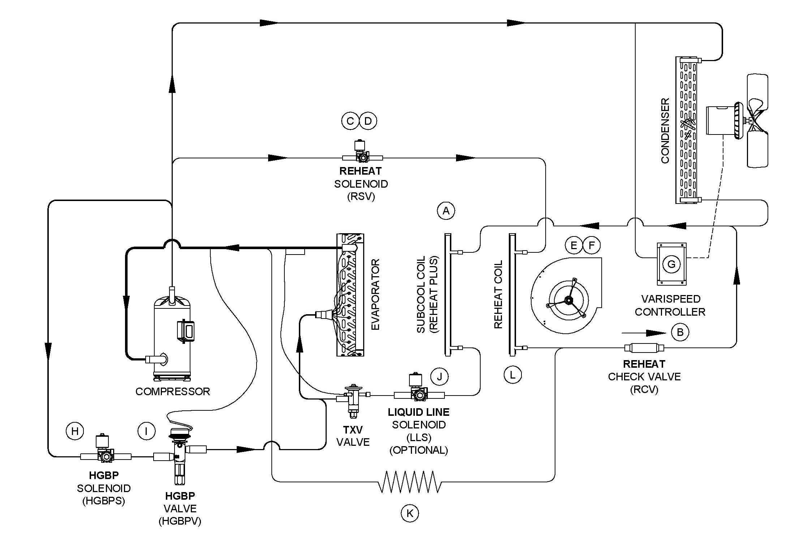
Hot Gas Reheat Plus Sub-Cooling
Notes:
Follow the liquid leaving the condenser coil. The normal sub-cooling for an air conditioner is 15 degrees. By adding the liquid to the sub-cooling coil and then running 55 degree air across this coil, sub-cooing improves to around 45 degrees. This allows you to select an 8 ton unit where the competition would need to use a 10 ton unit to accomplish the same performance.

Slide 18
100% Outside Air
Winter Design Conditions
175,000 BTUH Furnace
Ambient
0
Leaving Air
72
120
1800 cfm
Notes:
Heating to neutral air

Slide 19
“Refrigeration” Control
Liquid Sub-cooling Coil
  Raises leaving air temperature to reach Neutral Air faster
  Improves EER
  Two (2) degrees of sub-cooling equals one (1) percent increase in evaporator capacity
Hot Gas Reheat
  Raises leaving air temperature to room neutral conditions
  Cycling with discharge air thermostat
  Modulating with sensor.
Hot Gas Bypass
  Modulates to match the evaporator load
  Evaporator freeze protection
  Suction pressure activated

Slide 20
Product Line Overview

Slide 21
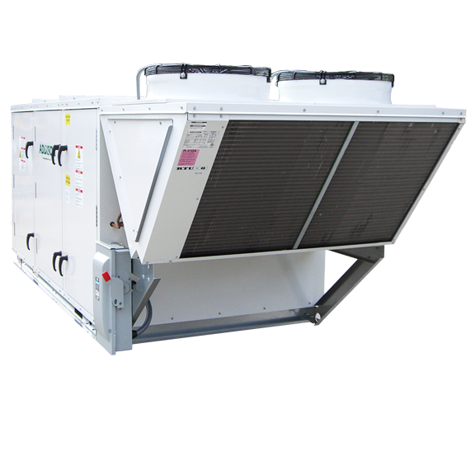
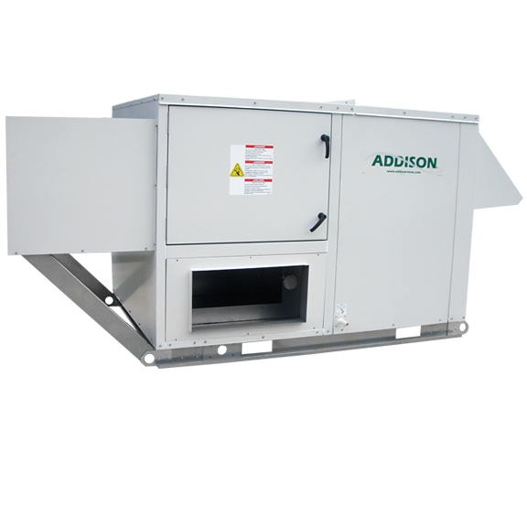
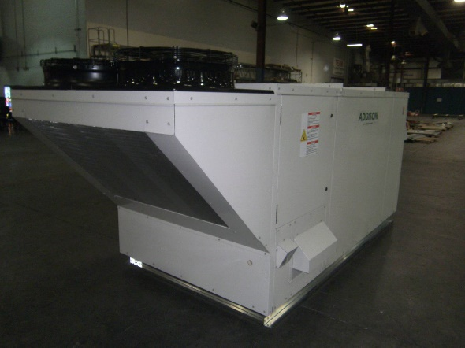
PR-Series
Packaged Rooftop Unit
3-70 tons (70 ton OSA, 60 ton RA plus ECW)
500-20,000 CFM
Five Versions:
  PRA = Air cooled condenser
  PRH = Air source heat pump
  PRW = Water source heat pump
  PRG = Geothermal water source heat pump
  PRF = Rooftop Air-Handler

Slide 22
PR-Series
Packaged Rooftop Unit
Standard Features:
  -2” double wall construction
  Two-coat, primer-paint finish on interior and exterior of cabinet panels.
  Sloped, stainless steel drain pan.
  Aluminum fin, copper tube evaporator coils.
Optional Features:
  Digital Scrolls
  Hot Gas Reheat
  Liquid Sub-cooling
  Hot Gas Bypass
  Energy Recovery Wheels
  Chilled Water 4 or 6 Row
  Hot Water Coils 2 Row
  Gas / Electric Heat
  Copper/Copper Coils
  Steam Coils
  ECM Motors

Slide 23
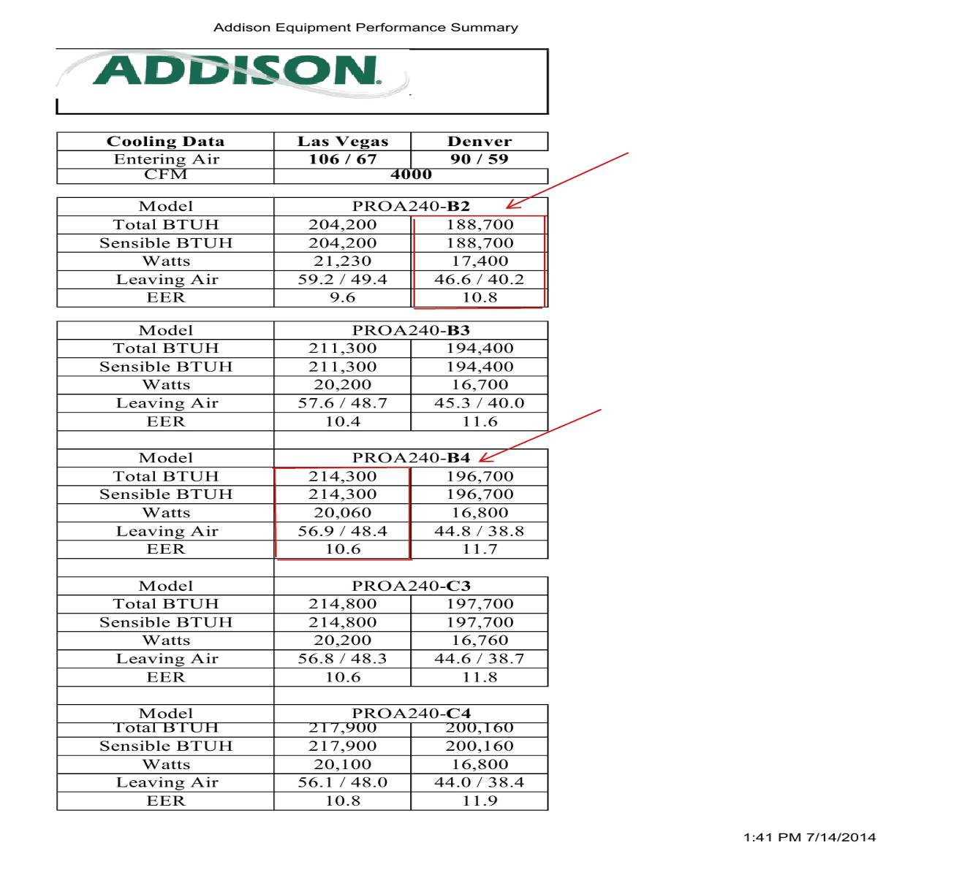
PR-Series

Slide 24
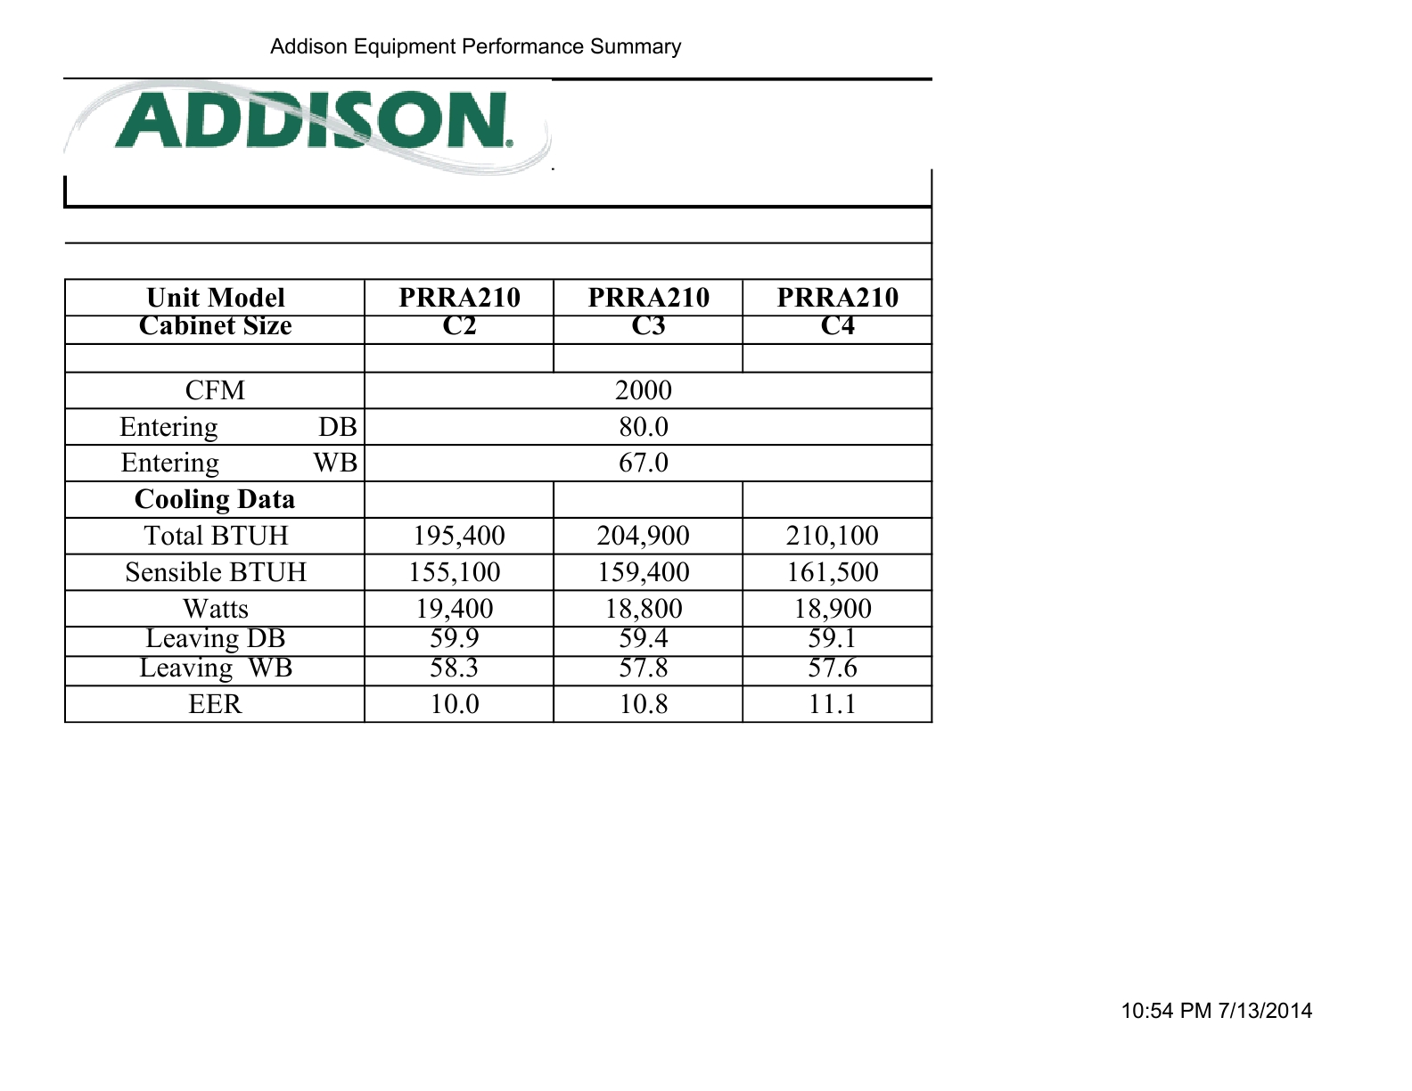
PR-Series
Energy can be further enhanced by selecting fans, energy wheels, sub-cooling, and compressors.

Slide 26
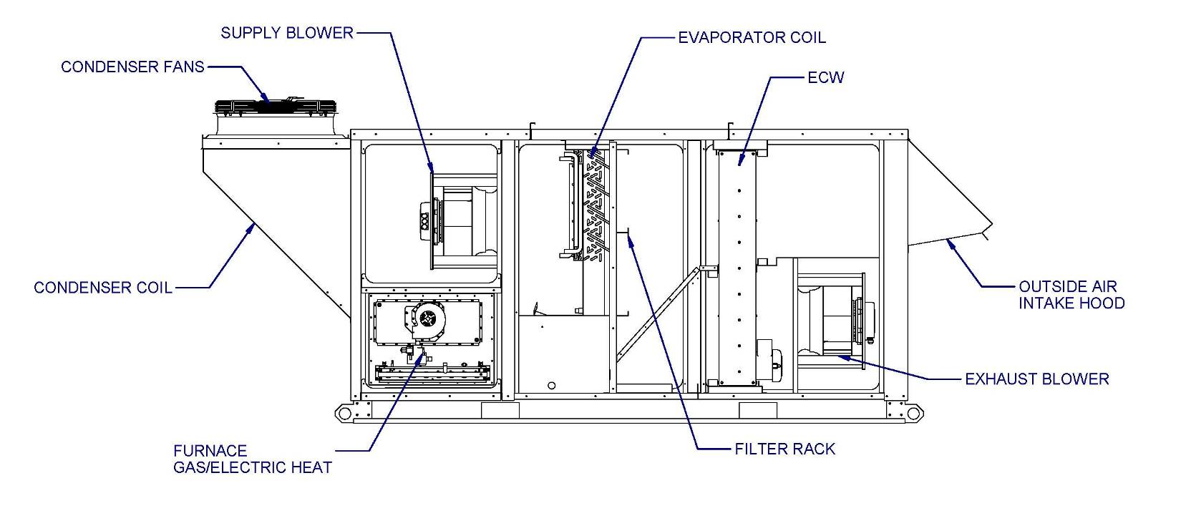
PR Series

Slide 27
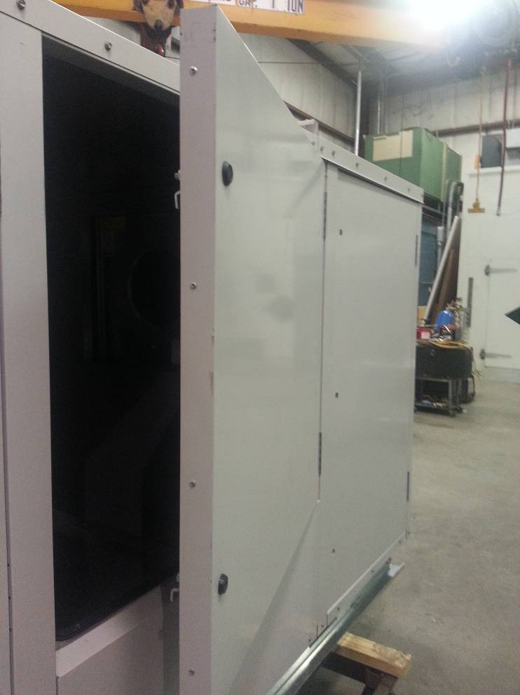
Access Door Design
Standard door design:
  Double-wall construction with 2”, R13 closed cell foam insulation.
  Positive door stop
  Access Ports for Test and Balance

Slide 28
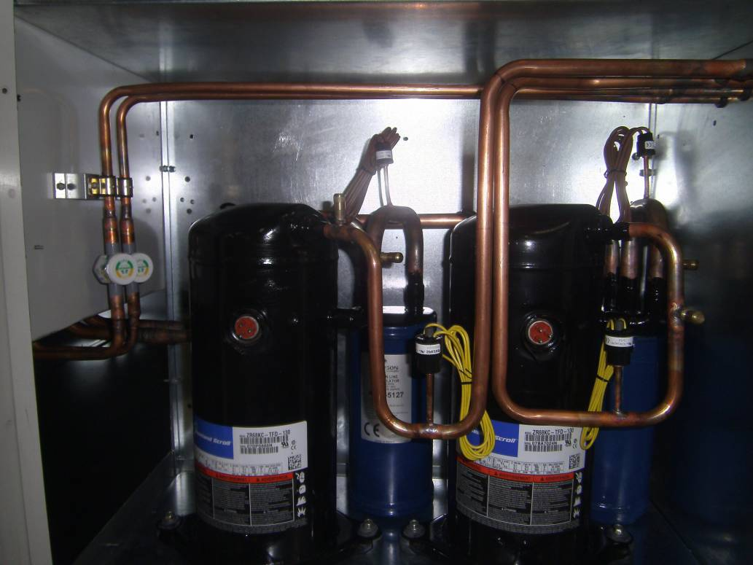
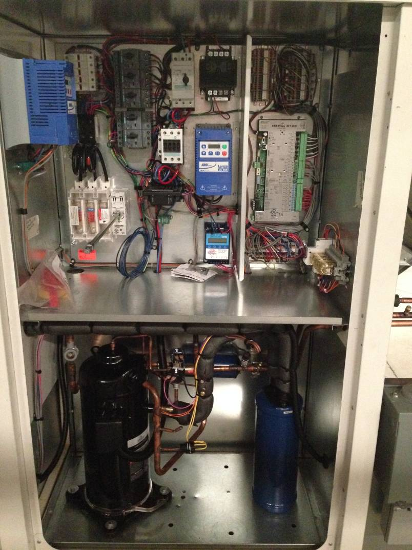
Ease Of Maintenance
Condenser access panel for ease of cleaning & maintenance
Easy access to Expansion Valves, Compressors and Controls
Touch-safe controls

Slide 29
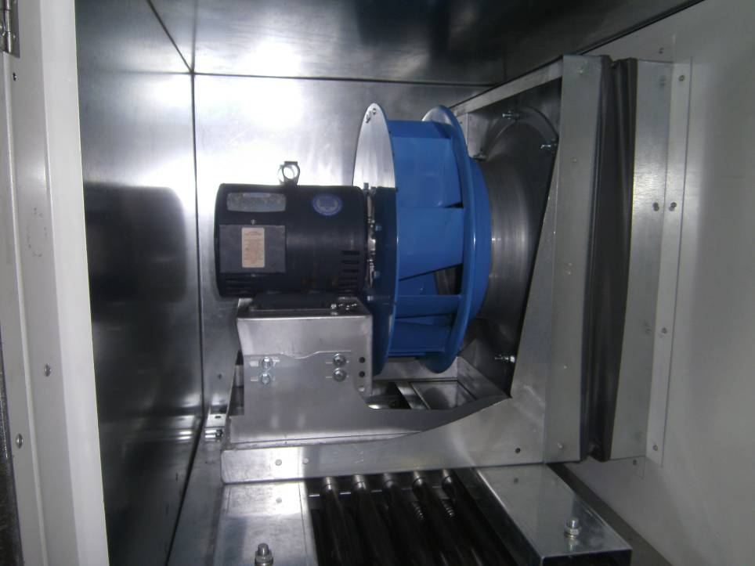
Supply / Exhaust Fan
Supply (& exhaust) fan is direct drive with high efficiency motor with Variable Frequency Drive rated for class II operation

Slide 30
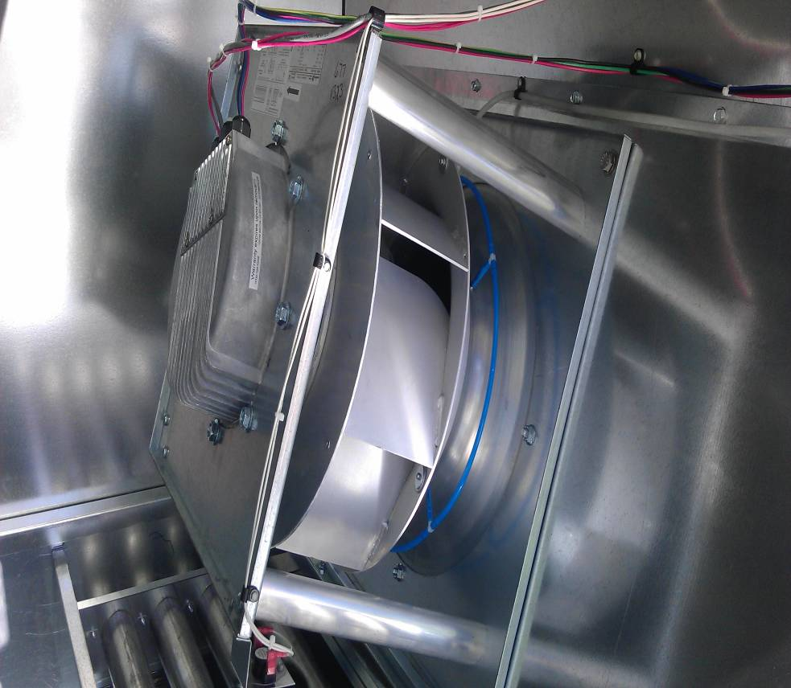
Supply / Exhaust Fan
Optional ECM Supply (& exhaust) fan provides high efficiency and quite operation and provide variable speed without the need of Variable Frequency Drive and associated wiring.

Slide 31
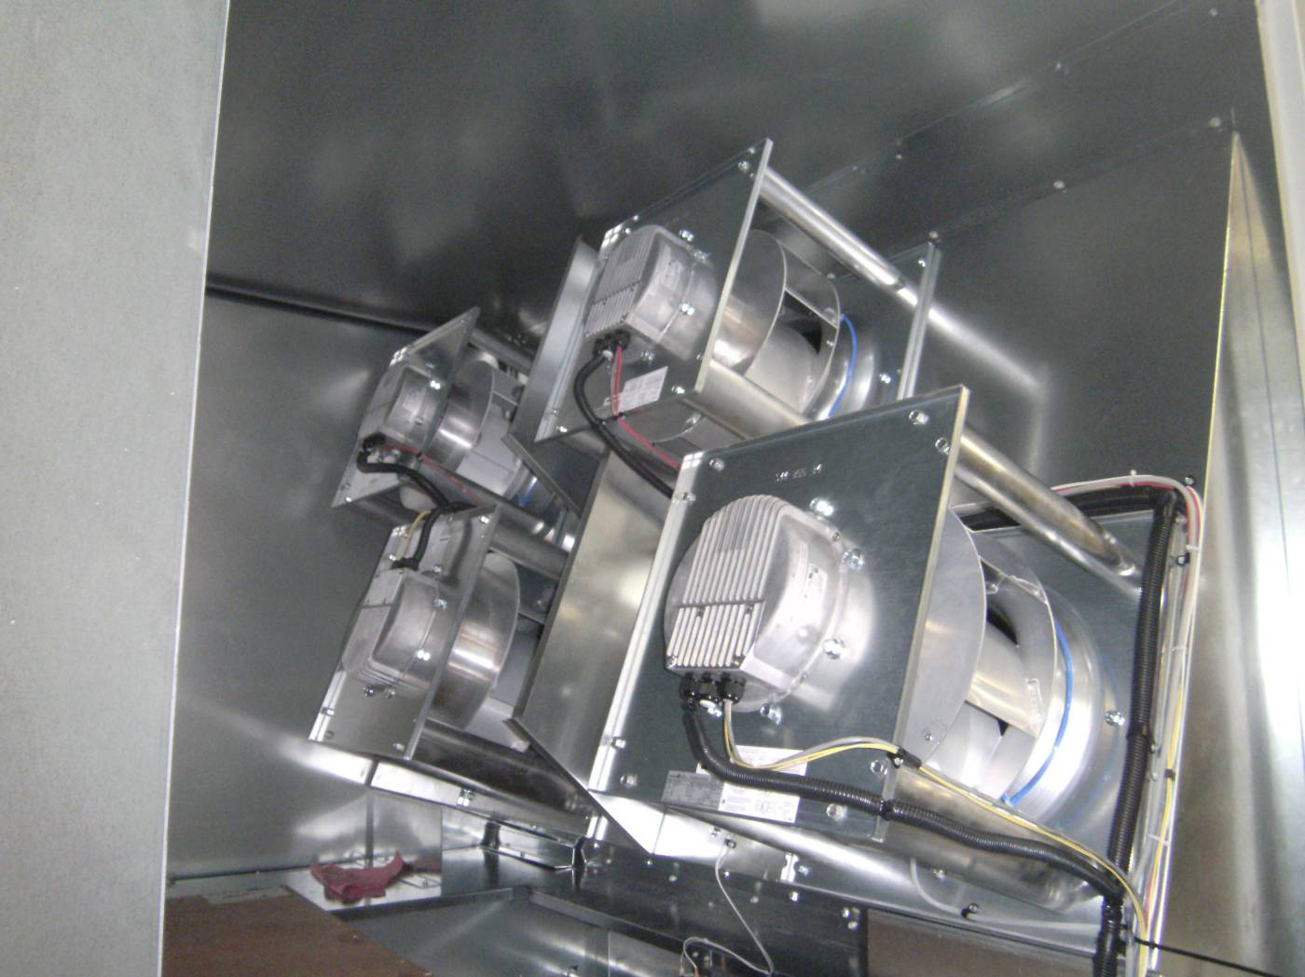
Supply Fan
Multiple fans used for higher airflows and/or higher static pressures – advantage of redundancy

Slide 32
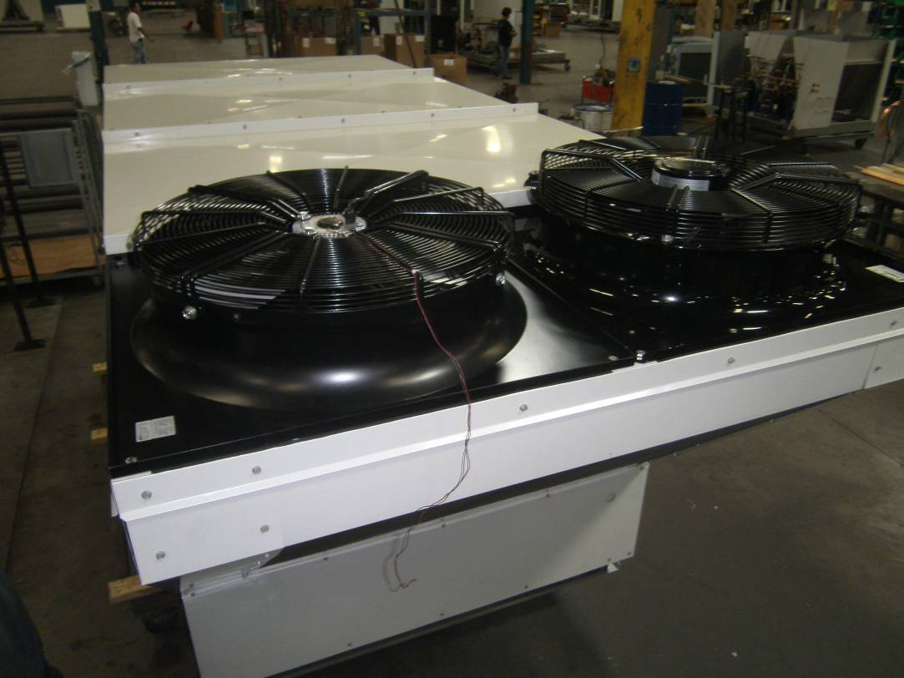
Condenser Fan
Vari-speed condenser fan
ECM Condenser fan optional

Slide 33
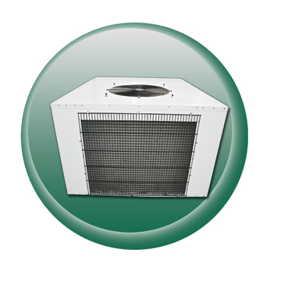
RC-Series
Split System Outdoor Condenser
RC-Series
Split System Outdoor Condenser
3.5-40 tons
R410A refrigerant
Three Versions:
  RCA = 100% Outdoor Air
  RCC= Cooling Only
  RCH= Air Source Heat Pump

Slide 34
RCA-RCC-RCH Options
Cycling or Modulating Hot Gas Reheat
Vari-speed Head Pressure Control
Low Ambient Fan Cycling (Std on RCA)
Liquid Line Check and Relief Valves
Internal Hot Gas Bypass with Liquid
Injection and Oil Separator for long refrigerant lines up to 200 feet
Hot Gas Bypass (Std on RCA)
Sight Glass
Adjustable High & Low Pressure Switches
Digital Scroll’s

Slide 35
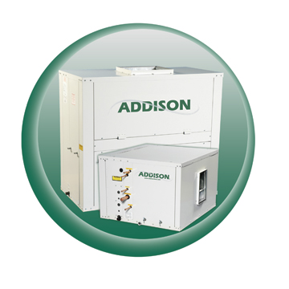
VC/HC-Series
Split System Indoor Air Handler
4-35 tons
R410A refrigerant
Three Versions:
  VCA/HCA = 100% Outdoor Air
  VCC/HCC = Cooling Only
  VCH/HCH = Air Source Heat Pump

Slide 36
VC/HC Series Air Handlers
Indoor Air Handling Units
  Optional features:
    4 & 6 row DX coils
    Chilled water coils
    Steam coils (1 row)
    Hot water coils (2 row)
    Hot gas reheat coil
    Liquid sub cooling coil
    Galvanized metal liner – Standard

Slide 37
VC/HC-Series
Split System Indoor Air Handler
Standard Features:
  Two-coat, primer-paint finish on interior and exterior of cabinet panels.
  Sloped, stainless steel drain pan.
  Aluminum fin, copper tube evaporator coils.
Optional Features:
  Hot gas reheat
  Hot gas bypass
  Liquid sub-cooling
  Hydronic heating
  Corrosion protection
  Phase/voltage monitor
  Spring Isolation
  VAV Control
  High efficiency filters

Slide 38
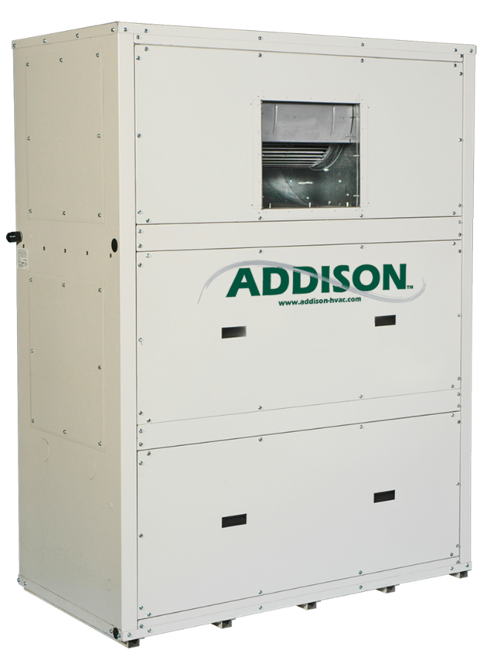
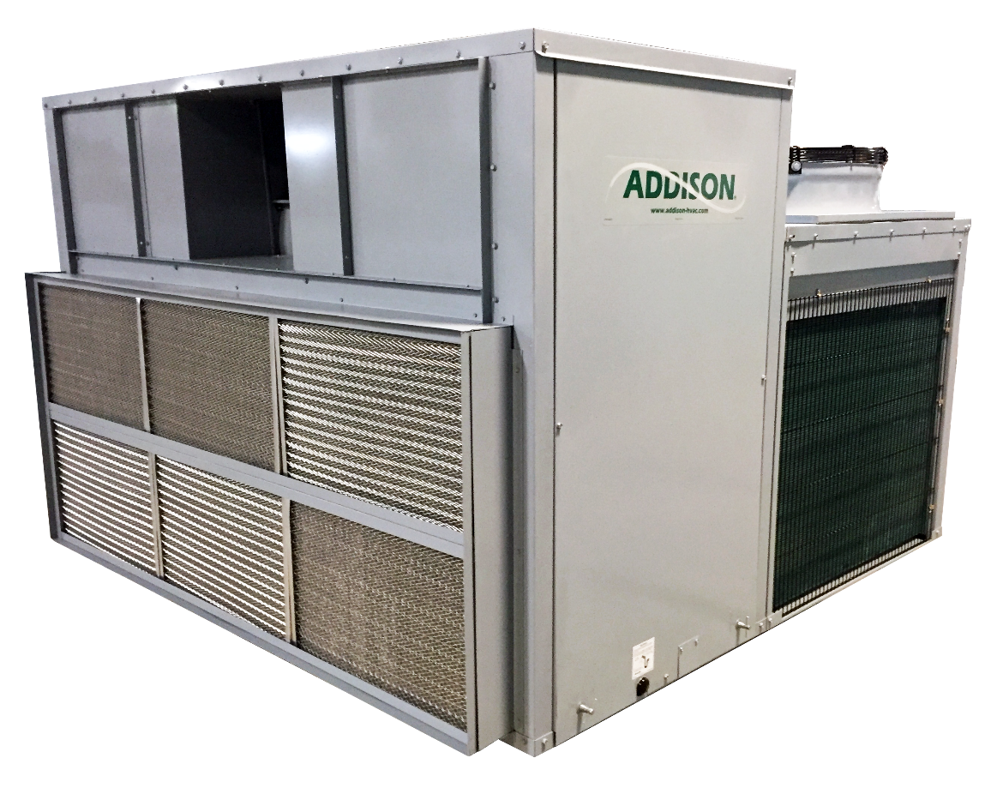
VWY, PCA/DCA
VWY- 100% OSA Vertical Water Source Packaged 8-30 Tons
PCA/DCA- 100% OSA Over/ Under Packaged Units 8-30 Tons

Slide 39
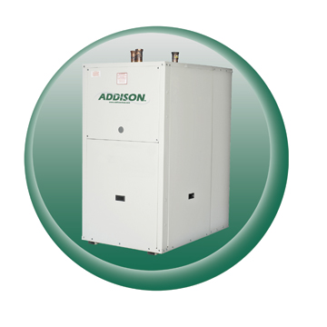
WW-Series
Water-to-Water Units
3-35 tons
R410 Refrigerant
Three Versions:
  WWC = Cooling Only
  WWH = Heating Only
  WWR = Heating & Cooling

Slide 40
WW-Series
Water-to-Water Units
Optional Features:
  Insulated coaxial heat exchangers
Optional Features:
  Heat recovery coil for domestic water heating.
  Cupronickel-inner coaxial coils

Slide 41
ALC Control System
Components:
I/O Pro Controller
BACview⁶
RS Room Sensor
RS Room Sensor

Slide 42
Special Protective Coatings
Coil Coatings
  Any of the Coils
Harsh Environment Protection
  Evaporator Coil
  Condenser Coil
  Reheat Coil
  Sub cooling Coil
  Cabinet
  All refrigeration components

Slide 43
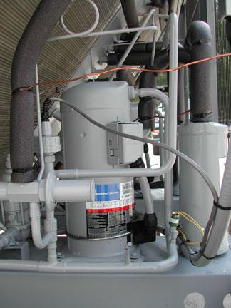
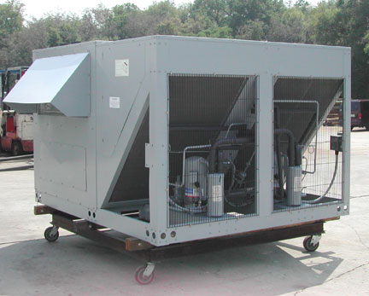
Harsh Environment Coating
10000 Hours of Salt Spray Testing
Entire unit will be coated inside and out.

Slide 44
Questions

